Slide 1

Digital Marketing Project Phase 2
COMPREHENSIVE DIGITAL MARKETING FOR RED TAPE

Slide 2
CONTENT OF THIS PROJECT INDEX
SI NO | PARTICULARS
Chapter I | Brand Study ,Competiter Analysis& Buyer’s/Audience’s Persona
Chapter II | SEO & KeyWord Research
Chapter III | Content Ideas And Marketing Strategies
Chapter IV | Content Creation And Curation
Conclusion | conclusion Of the Project
Faculty Guid: TEAM MEMBERS
SK. K. ZELANI G.Hemalatha, K.Ajaykumar, S.Venugopal, Y.Kalyani
MPES , GUNTUR

Slide 3

RED TAPE The focus of red tape research so far, has been on public organizations, their organizational rules, and on managers’ perceptions of red tape. In the literature, it is suggested that red tape research should focus more on red tape that can be considered as existing objectively and on the compliance burdens of stakeholders such as businesses and citizens. For this purpose, the current definitions of red tape are too narrow or hardly applicable in practice.
.

Slide 4
CHAPTER I

Slide 5
Brand Study , Competitor Analysis & Buyer’s/Audience’s Persona
Research Brand Identity
Competitor Analysis
Buyer’s/Audience’s Persona

Slide 6

Research Brand Identity
Mission/Values:
Red tapes ideals stem from our “Think Different” strategy using innovative, interactive, traditional, and digital media options as tools.
We endear experiences of happiness, wonder, limitless possibilities, and inspire positive connections between brands and consumers.
Team up with RED TAPE and get your brands to speak directly to consumers instincts, emotions, and values.

Slide 7
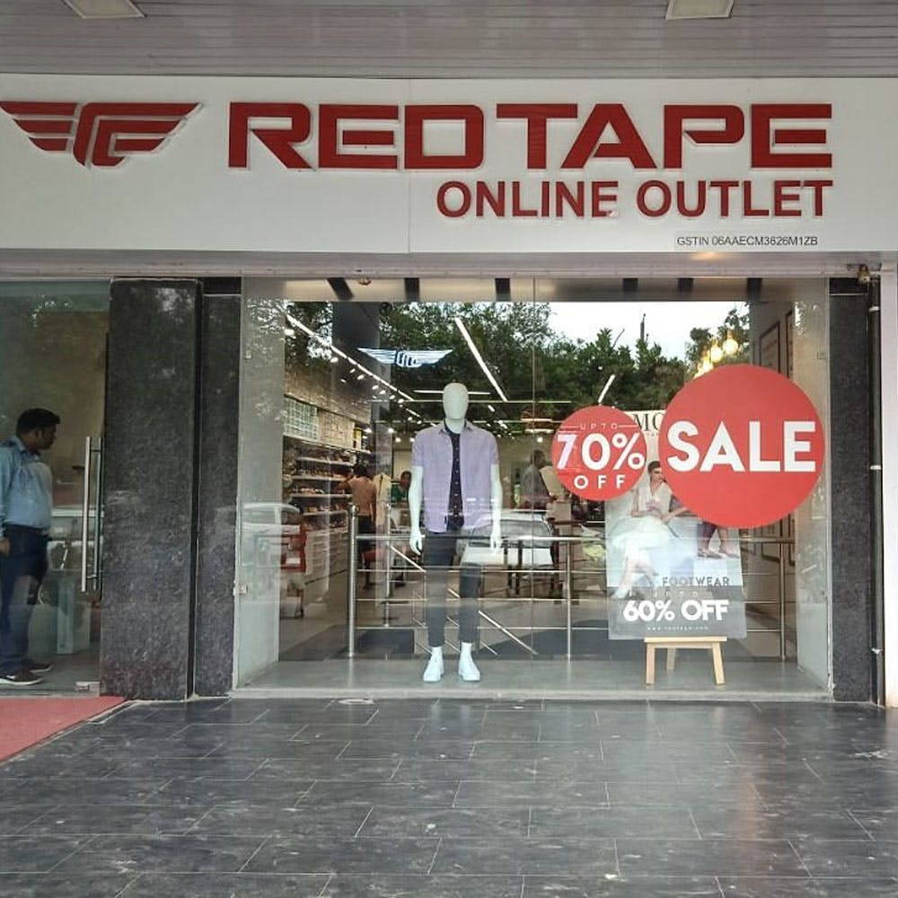
Unique Selling Point:
Streamlined Communication: Utilize targeted messaging and channels to effectively communicate complex regulations in a clear and understandable manner.
When it comes to digital marketing for Red Tape, some unique selling points could be leveraging social media platforms to showcase the brand's authenticity, engaging with customers through interactive content, and using targeted ads to reach the right audience.

Slide 8

Analyze Brand Tone and Identity:
Developing a brand identity requires more than creating a logo. Although a logo can be the symbol of a business, it is not the entirety of a brand. In fact, creating a logo is just one small step toward developing a strong brand identity.

Slide 9
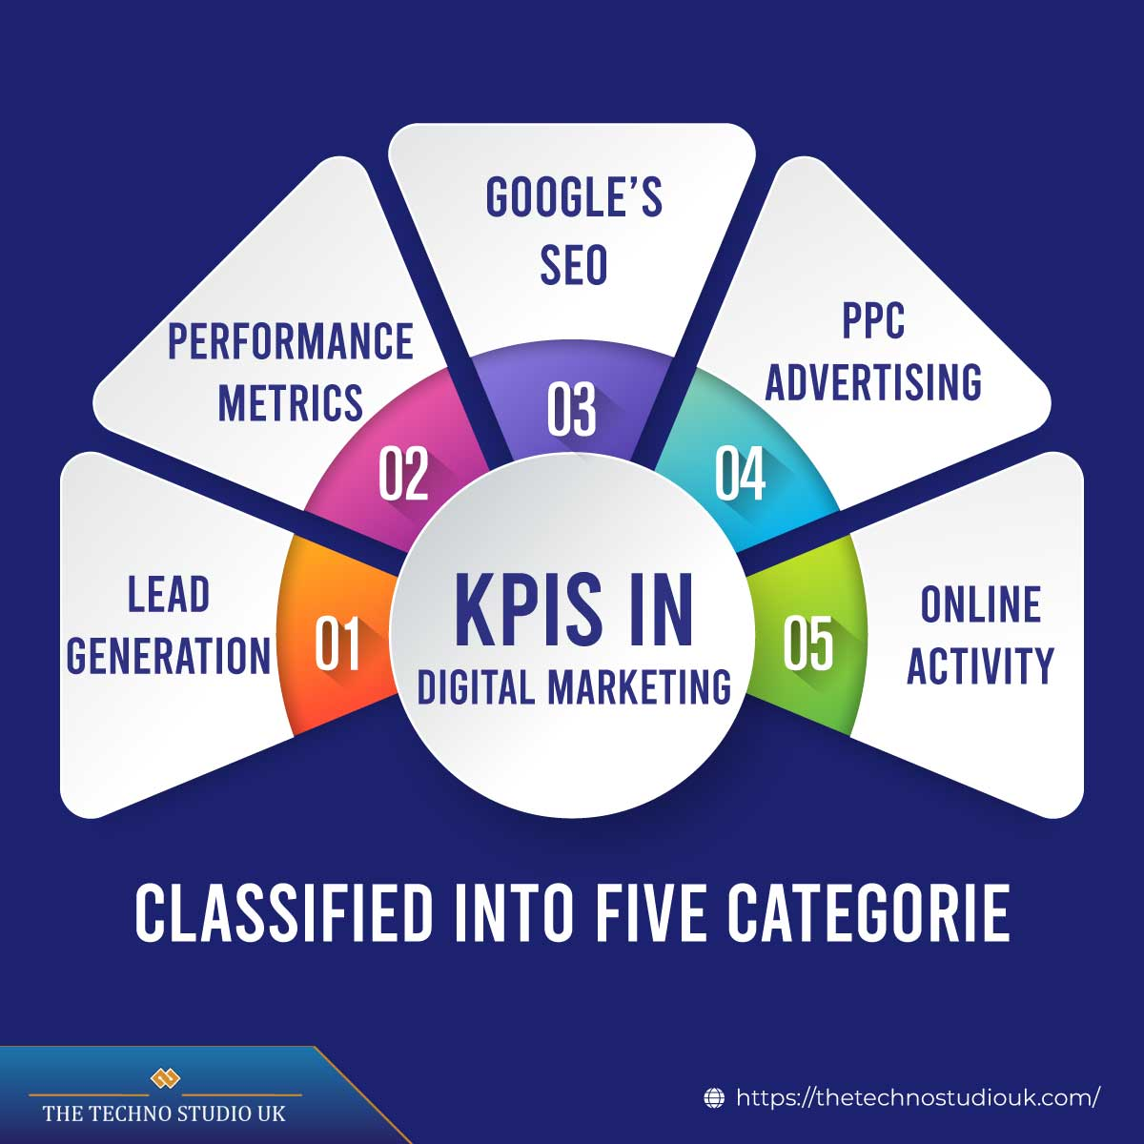
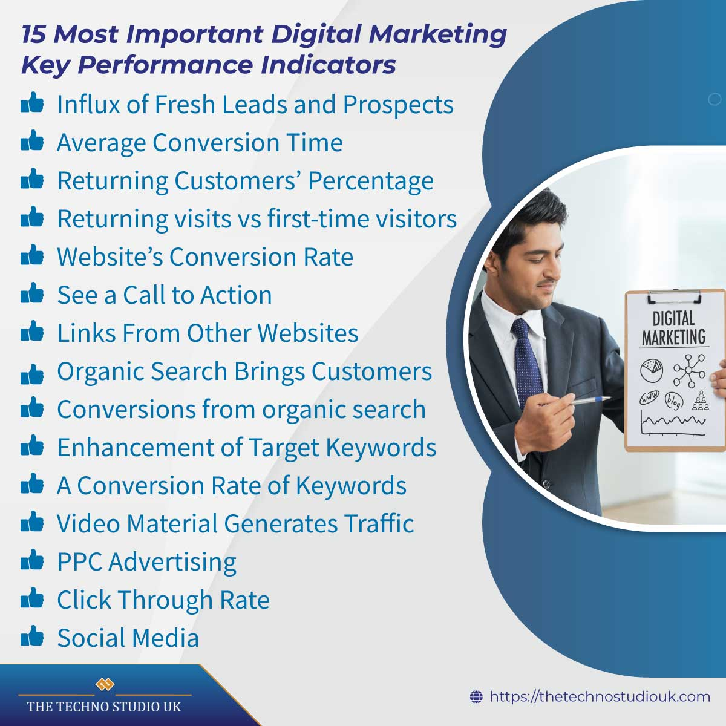
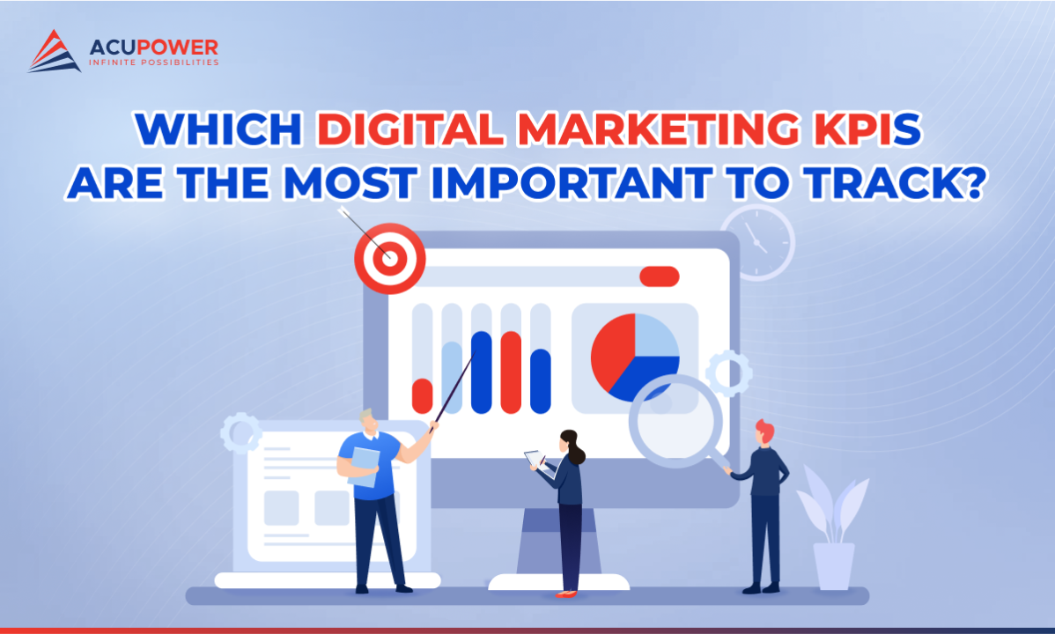
KEY PERFORMANCE INDICATOR
IDEA 1
Goal :CPL is often utilized by businesses who sell subscription services or high-value products.
KPI: A KPI is a key performance indicator that measures how your company is performing at achieving a certain goal or objective.
IDEA 2
Goal :. A Marketing Qualified Lead (MQL) is a lead who has indicated interest in what a brand has to offer based on marketing efforts or is otherwise more likely to become a customer than other leads.
KPI: A great way to analyze and report on your KPIs is to create custom dashboards in your automation software.
IDEA 3
Goal: What Is the Cost of Acquisition? The cost of acquisition is the total expense incurred by a business.
KPI: Popular marketing KPIs include Cost Per Lead (CPL), Marketing Qualified Leads (MQL), Cost Per Acquisition (CPA), and Website Visits Per Marketing Channel.

Slide 10
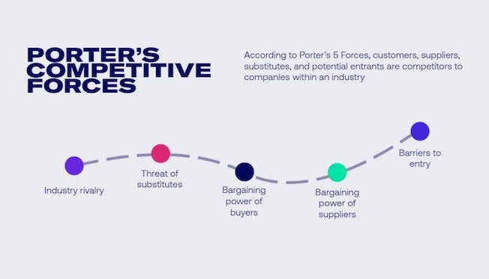
COMPETITOR ANALYSIS
SEO competitor analysis
Compare website performance e.g. page speeds.
Find keyword gaps.
Compare backlinks and where they get them.
Look at strategies on how they rank for more keywords – e.g. do they have a blog or resources section?
Examine top pages and traffic.

Slide 11
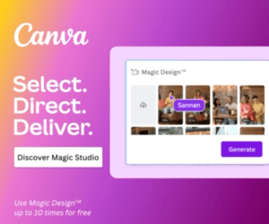
SWOT ANALYSIS
Mother Dairy
Strengths:
An international brand with present across the US, UK, France, Germany, West Asia and South Africa. It has a retail presence in 50 countries with production facilities in over 26 countries
Exclusive Red Tape stores, hence the reach of red tape is now increasing
Contribution to environmental preservation and community wellbeing
Weaknesses: Foray into apparel industry which already has a very tough competition means limited market share.
Offers Lower profit margins to the multi- brand retailers than the local brands also.
Opportunities:
To introduce independent sub brands catering to middle class customers without brand dilution.
Red Tape can tap the youth, who are becoming more fashion conscious.
Increasing disposable incomes.
Threats: Foreign brands bring in more competition and hence can affect Red Tape's business.

Slide 12
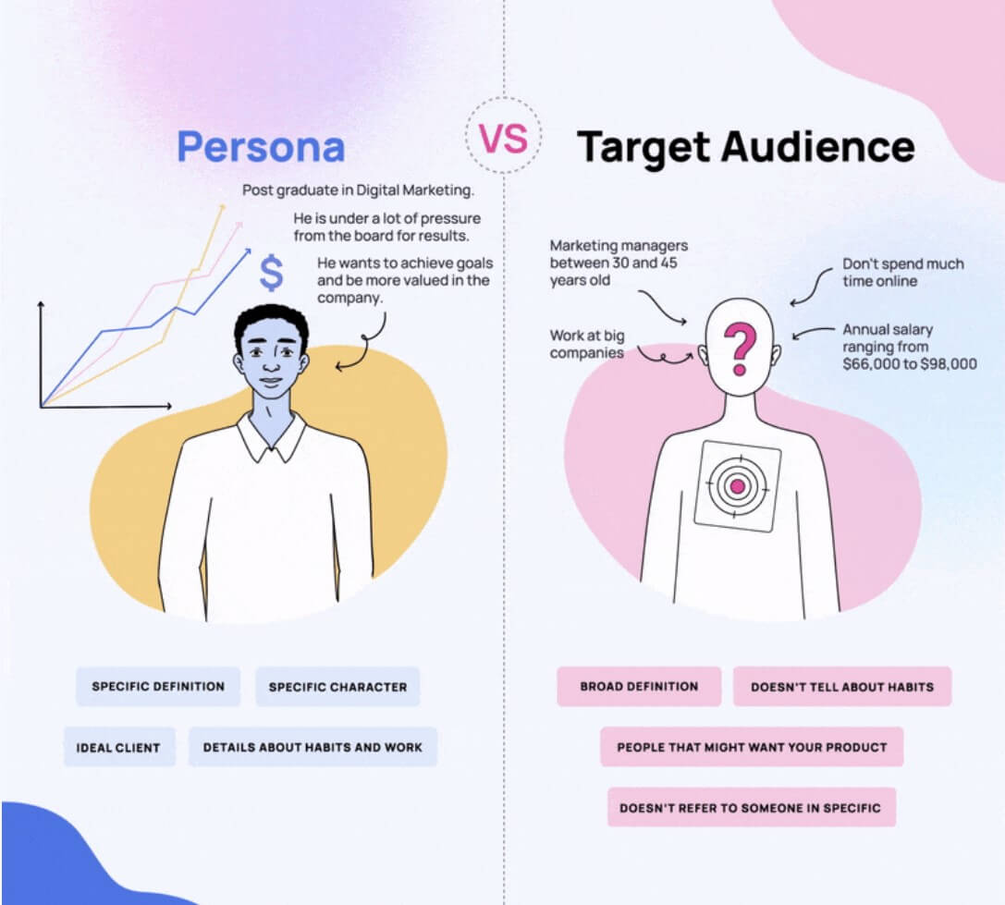
Buyer’s/Audience’s Persona
Brands that feel human to their target market succeed in building a rapport with them. This improves the brand reputation with both old and new customers.
With this in mind, we highly recommend creating buyer persona templates before launching a business or a marketing campaign.
This is a great practice for your next social media, content, or web campaigns, as well.

Slide 13
CHAPTER II

Slide 14
SEO & KEYWORD RESEARCH
SEO Audit
Keyword Research
On Page Optimization

Slide 15

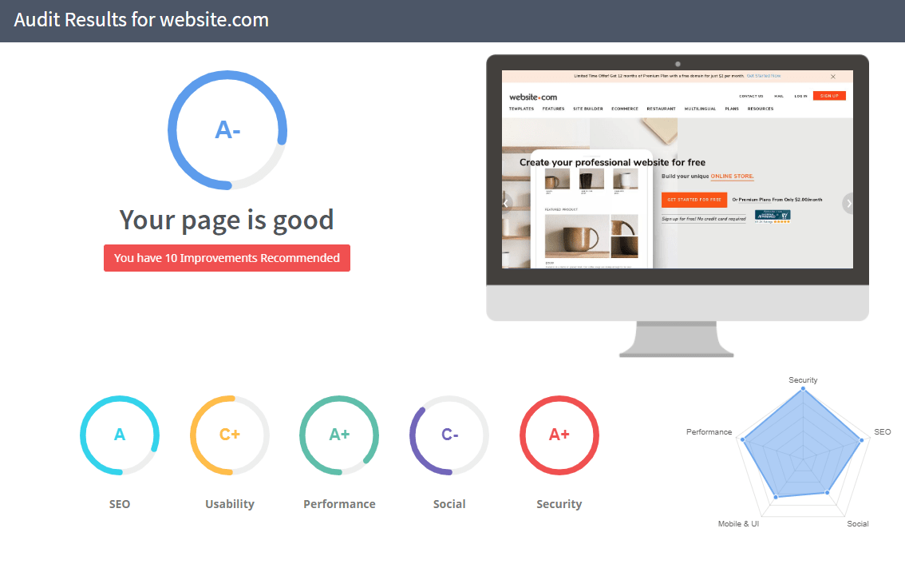
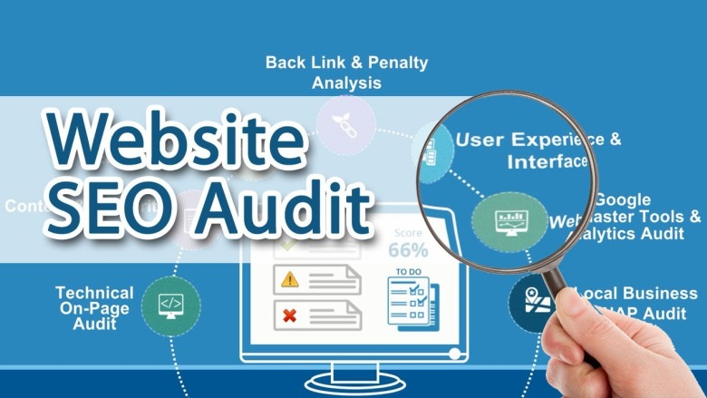
SEO AUDIT

Slide 16
Long & Tail Keyword Exploration
Related searches for Red Tape
Red Tape Login
Red Tape Products list
Red Tape Wikipedia
Red Tape Website
Red Tape Products
online purchases from Red Tape
Red Tape online digits

Slide 17
On Page Optimization
Meta Tag optimization
Optimized Title: “Red Tape” products for societies and Organizers.
Title Tag
Optimized Meta Description: Explore our range of high - quality Tape products tailor-made for families from Red Tape Toolkit.
Meta Description

Slide 18




Content Optimization
Content Optimization
Keyword Usage
Content Quality&Relevance
Mobile Optimization
Call to Action

Slide 19
CHAPTER III

Slide 20
Content Idea Generation & Strategy
Content Calender
WEEK 01
SUMMER TIME WITH MOTHER DAIRY
WEEK 02
GLOBAL FLAVOURS,LOCAL DAITY
1
Sep 12th Instagram&Facebook: video
Sep 22nd Instagram: Story
1
2
Sep 19th whats App:Status
Oct 3rd Instagram:Story Poll
2
3
Sep 21st Google: Images Collection
Oct 6th Instagram:story Highlights
3

Slide 21
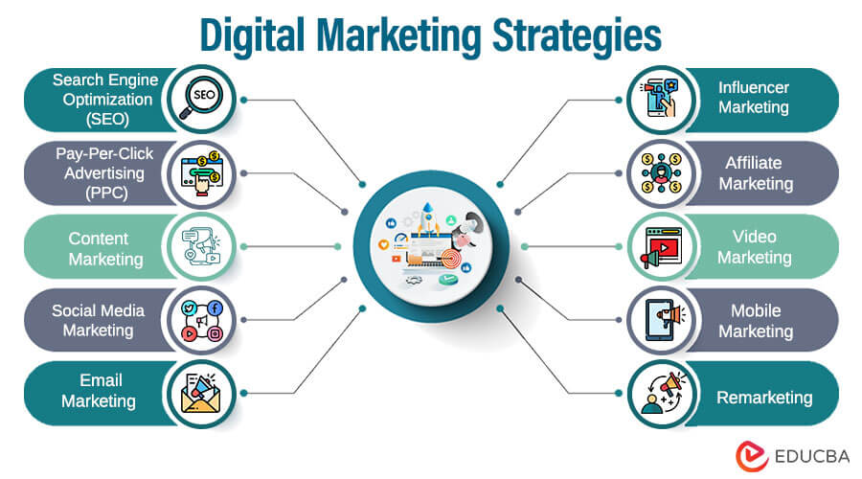
Marketing Strategies
Reflection on the Content Ideas
User Engagement
Storytelling Works
Consistency
Reflection on Marketing Strategies
Algorithm Challenges
Resource Allocation Feedback

Slide 22
CHAPTER IV

Slide 23
Content Creation and Curation
Post Creation
Designs/Video Editing
Social Media Ad Campaigns
Email Ad Campaigns

Slide 24
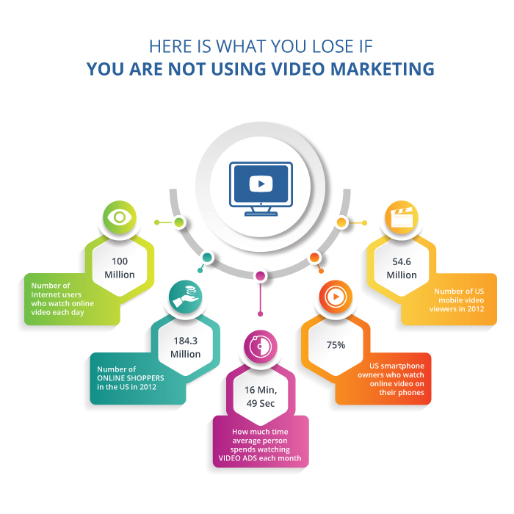
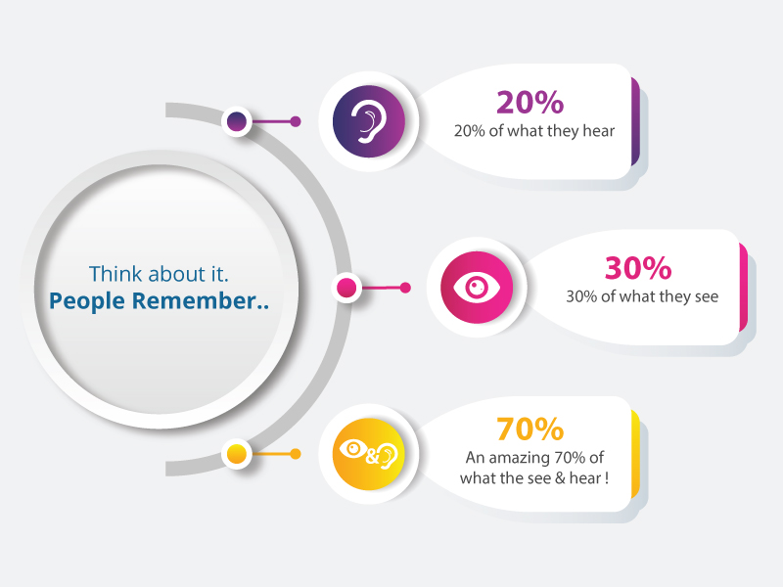
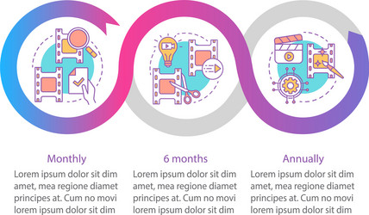
Post Creation & Design / Video Editing
Social media. Social media sites offer excellent marketing tools for graphic designers to build their business.
Your website and SEO.
Vlogging and blogging.Referrals and reviews.
FORMATE 1
FORMATE 2
FORMATE 3

Slide 25
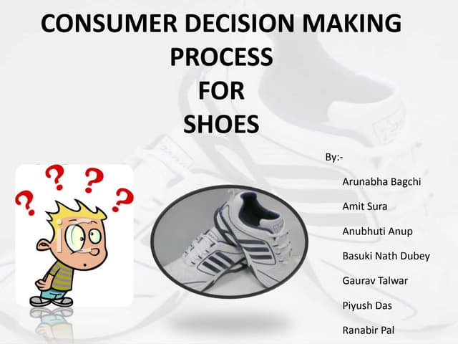
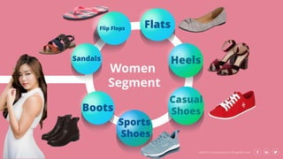
Posted Material

Slide 26
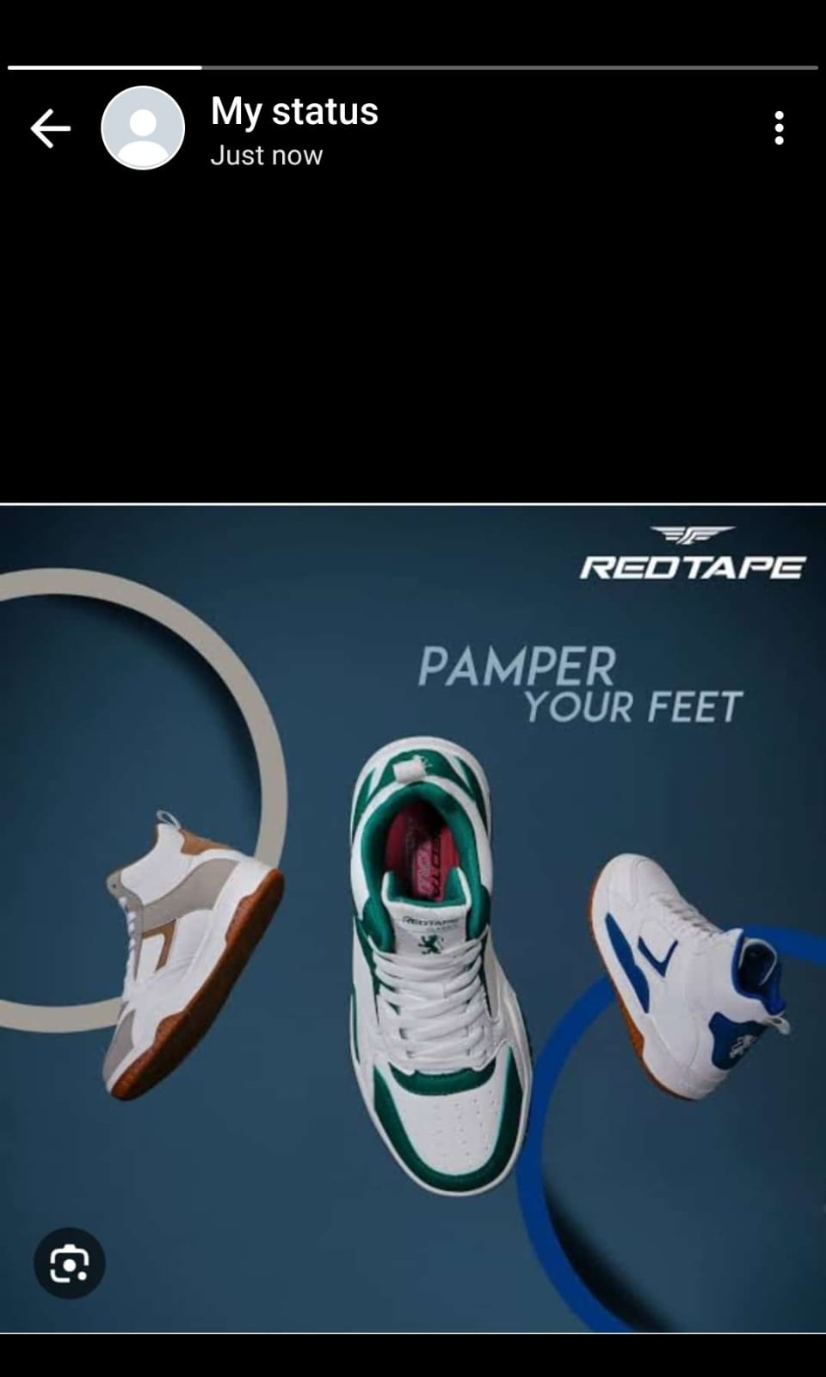
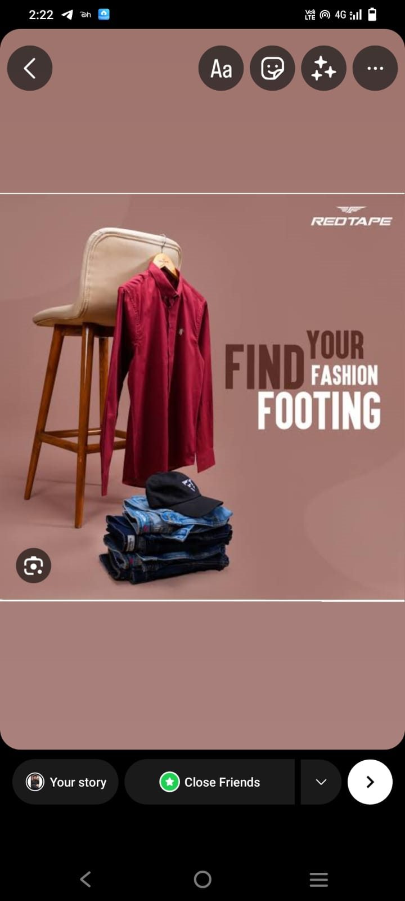
Instagram Story: Utilize the Stories feature on Instagram for three consecutive days, Share behind the scenes glimpses, polls, quizzes, or sneak peeks etc to encourage audience participation. Once uploaded use the story highlight feature on Instagram and save the 3 story with an appropriate name for each

Slide 27

Designs/ Video Editing

Slide 28



Social Media Ad Campaigns
Step 1: Define Your Social Media Campaign Goals.
Step 2: Identify the social media channels you'll use.
Step 3: Plan your social media campaign strategies.
Step 4: Choose the metrics you want to monitor.
Step 5: Create a social media content calendar.
Step 6: Design Your Marketing Assets Using Free Online Tools.

Slide 29
Conclusion
Thanks for providing is golden opportunity to perform this for Power point presentation and a very thanks for SMARTINTERNZ for providing this internship
From
SK. K. ZELANI . Faculty Member
Team Members:
Gandikota Hemalatha
Kavuri Ajaykumar
Sakhi Venugopal
Yarrasingh Kalyani

Slide 30


